Slide 1
These are my presentation slides for this project. To watch a recorded video of my presenting the slides, please click on the following link:
https://us02web.zoom.us/rec/share/k37ZickResePMqFShVWk2W46a8JNvcJ-dC5XsQsMEQKAMQZAfu4x14OFR3mrq-pO.0QjbTwKl4Ka4waHi?startTime=1608130856000

Slide 2
2.5D Scene: Islamic Architecture
CS 460: Graphics
Final Project Presentation
Ayah Aboelela

Slide 3

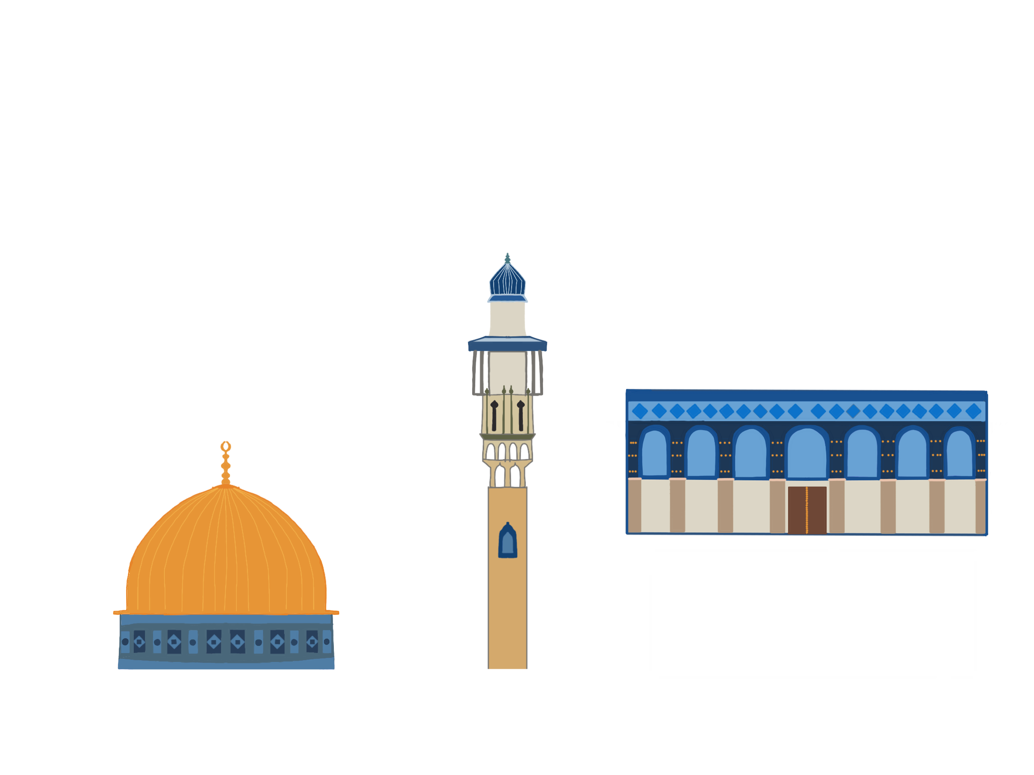



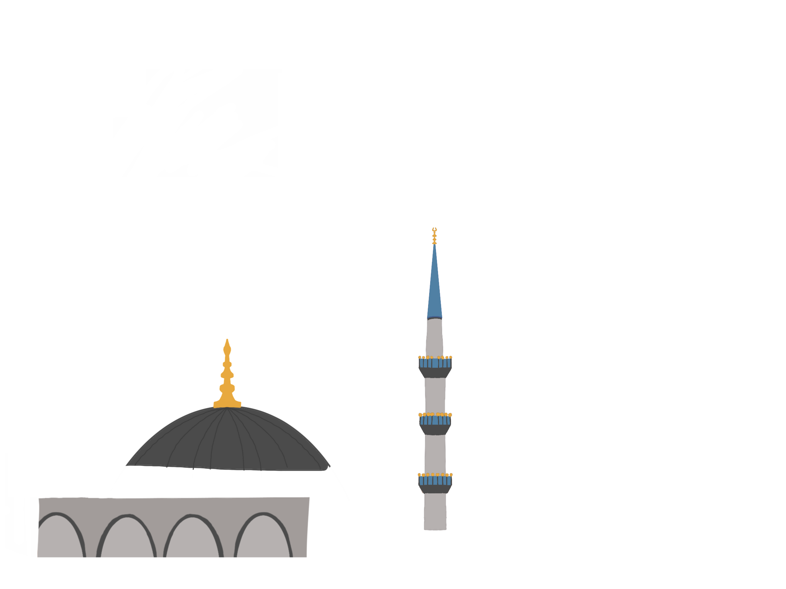

Step 1: Illustrations!

Slide 4
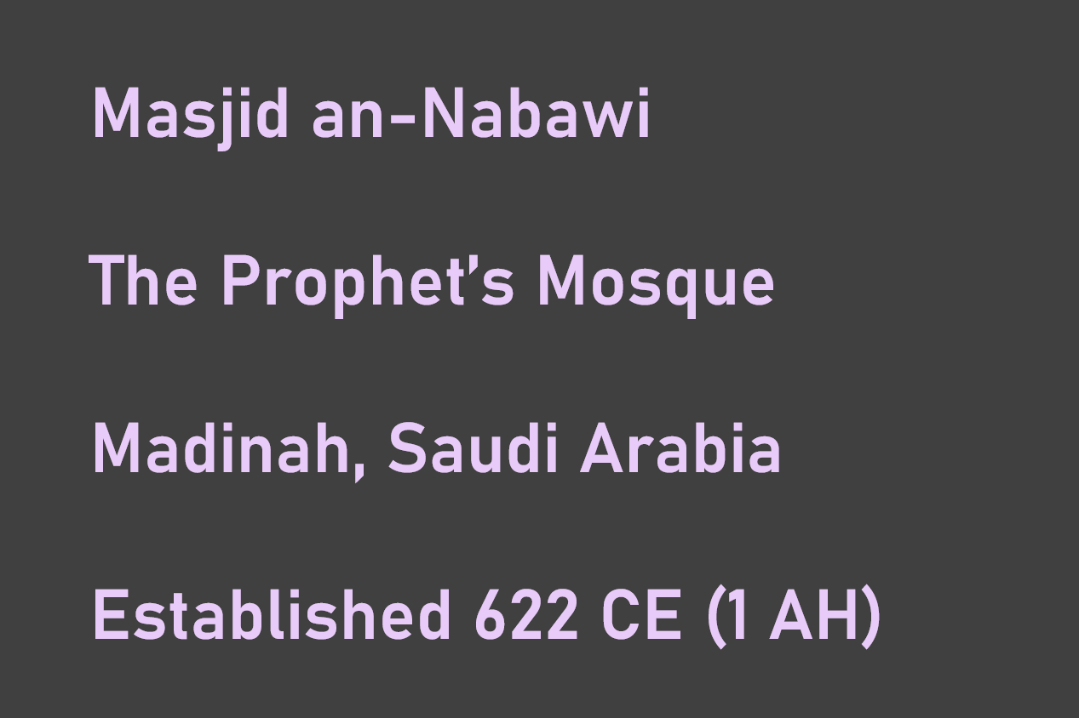
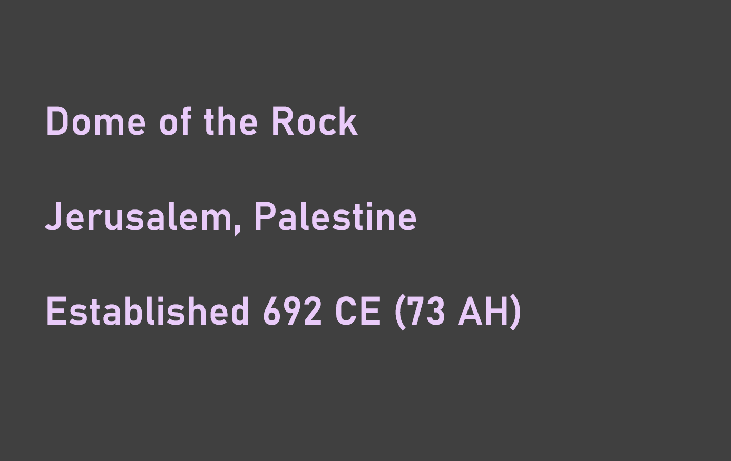

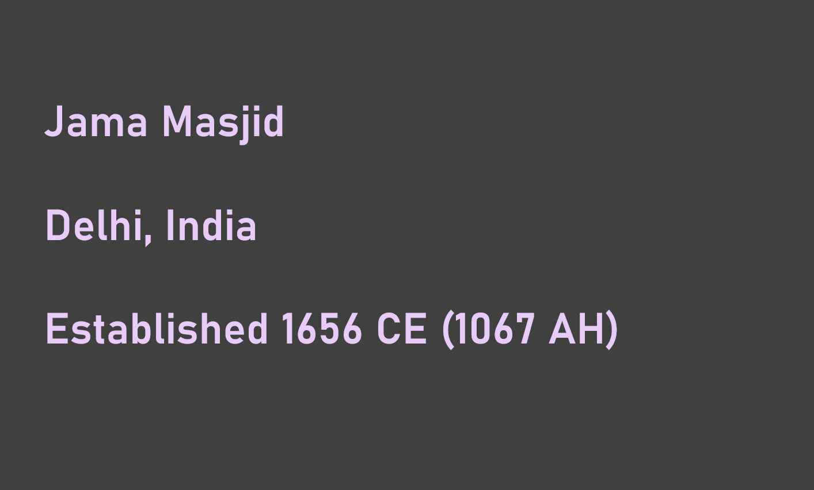
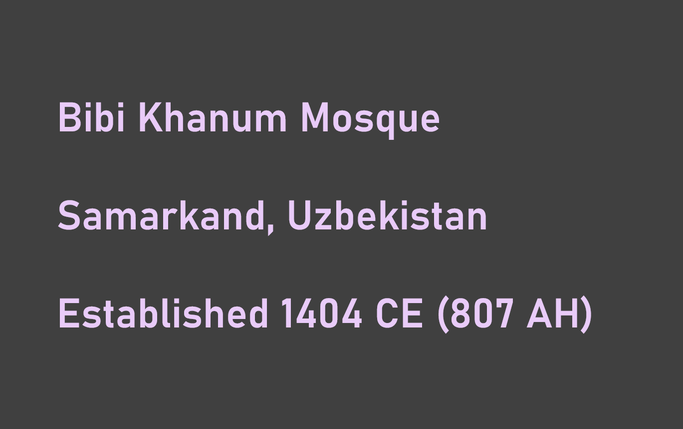
Step 2: Info Panels!

Slide 5
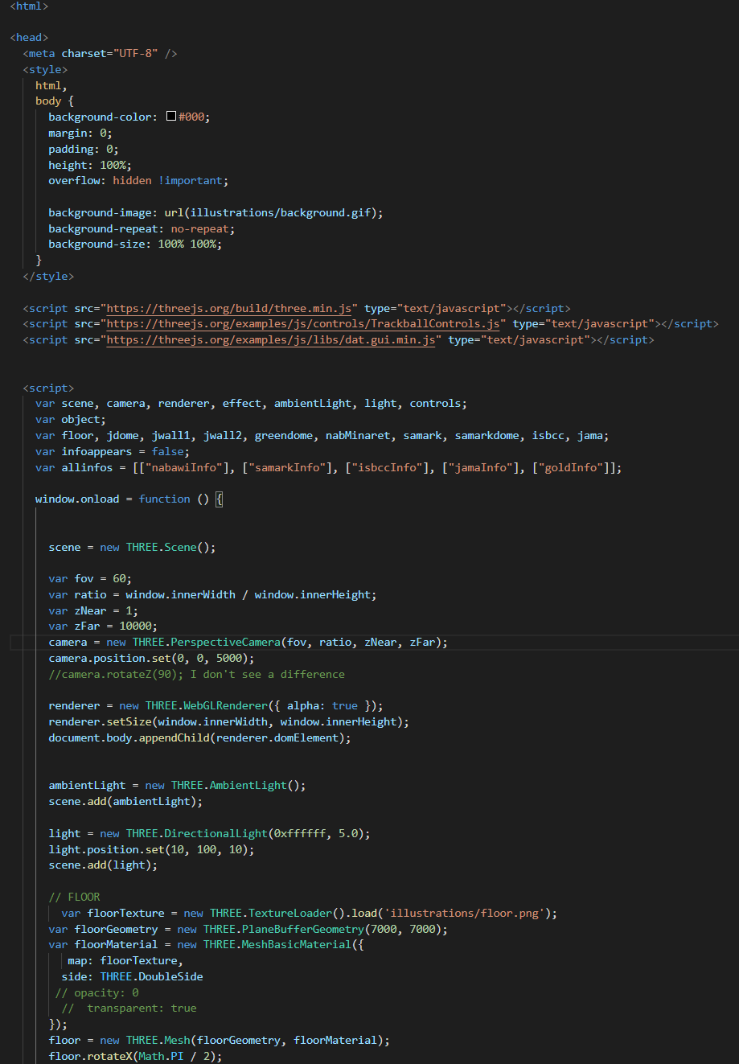
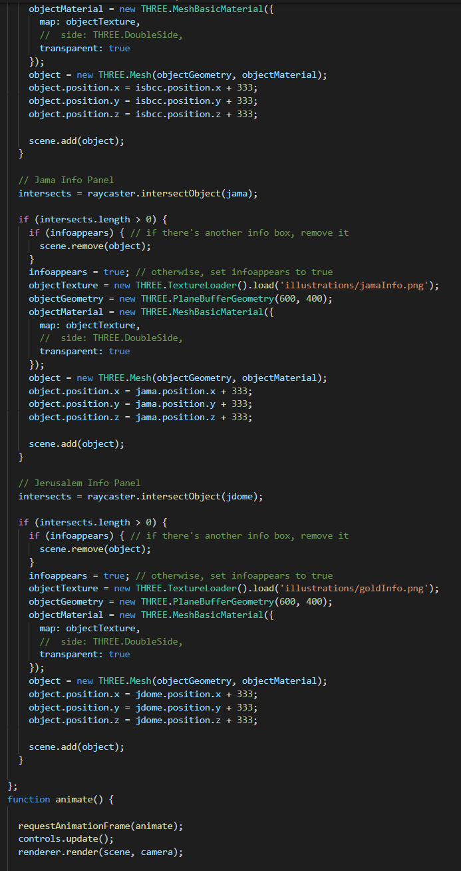
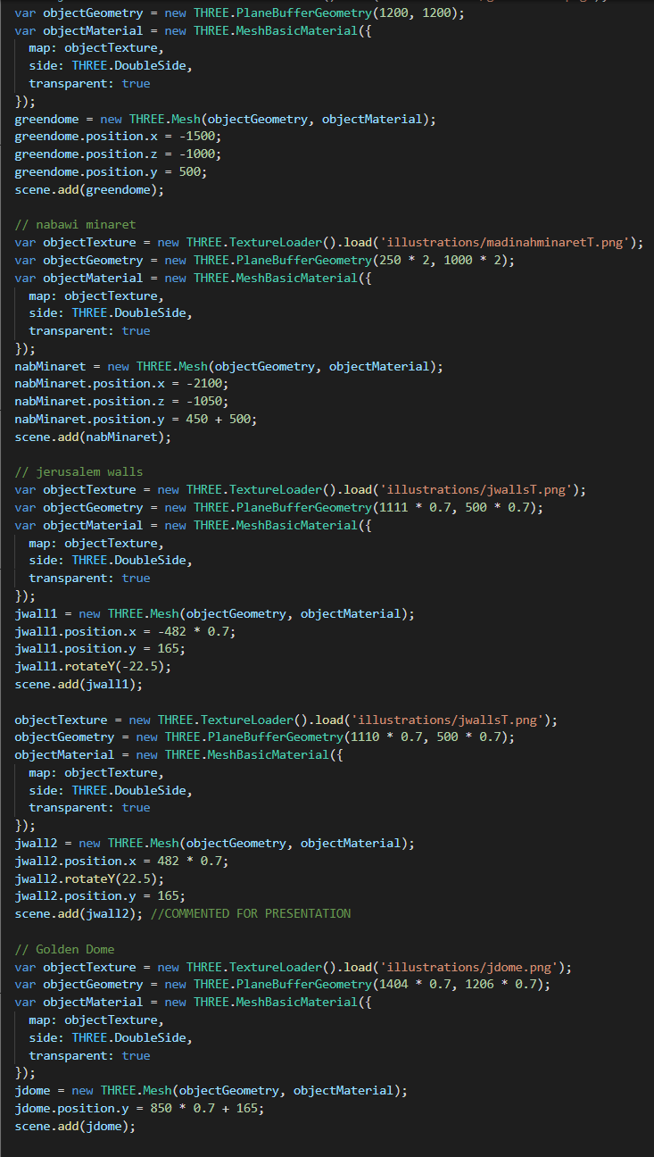
Step 3: Code!

Slide 6
